Slide 1
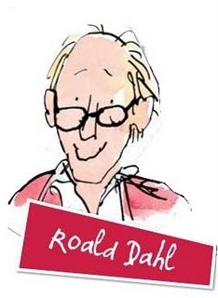
By Noelia Villafañe Fraile

Slide 2
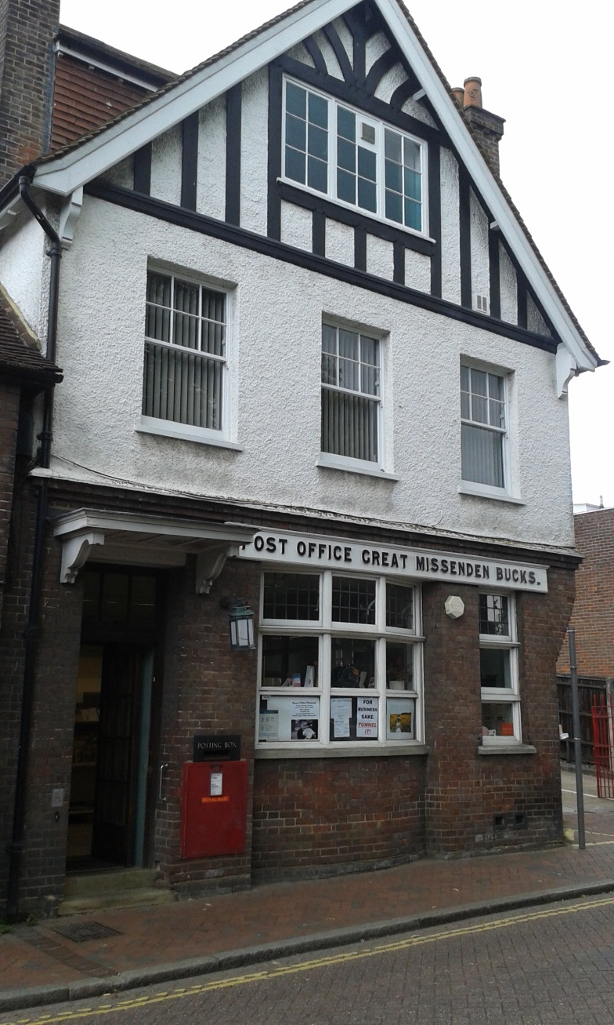
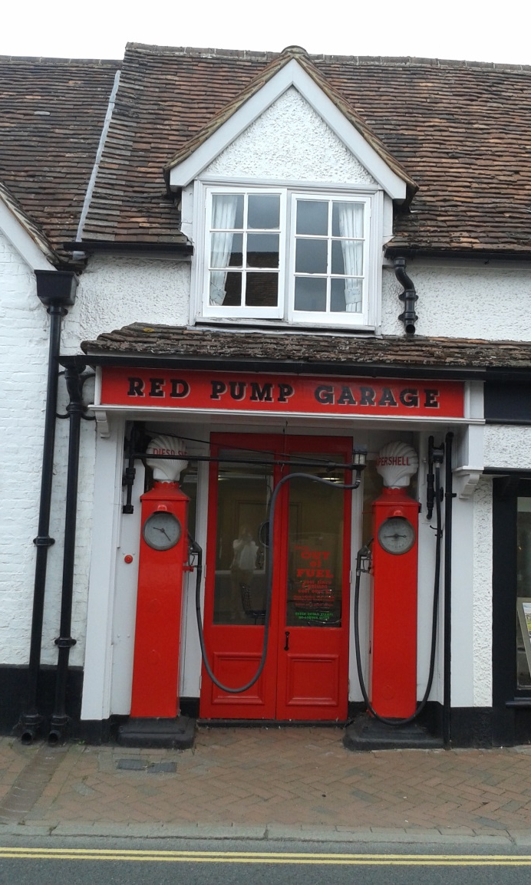
Great Missenden
Petrol station

Slide 3
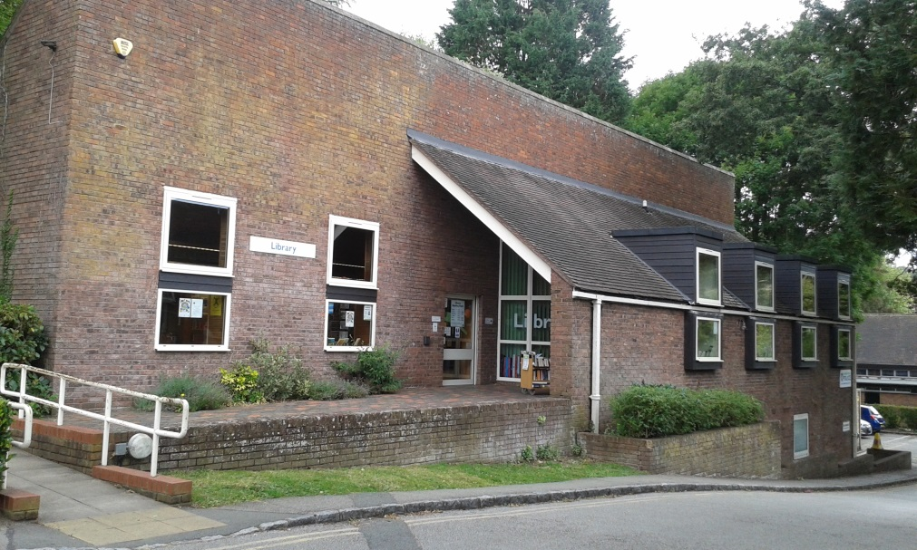
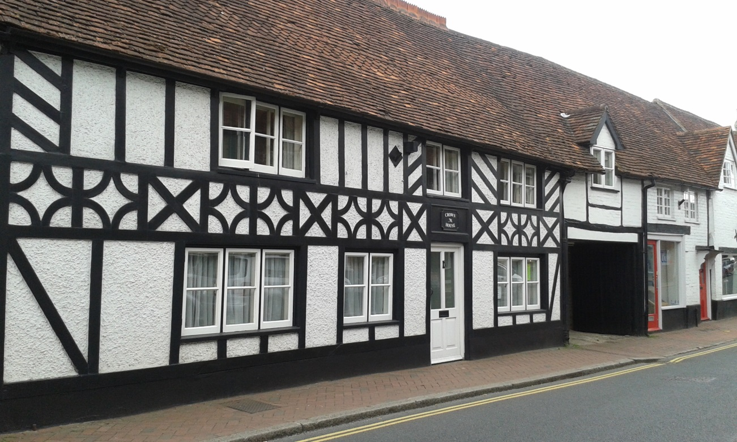
Library
Sweet shop

Slide 4
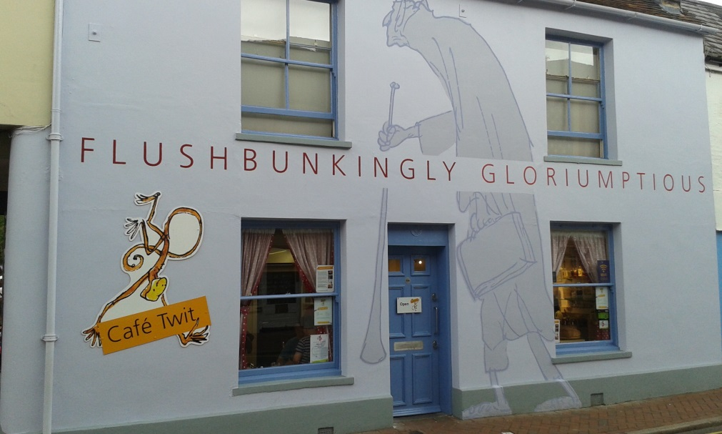
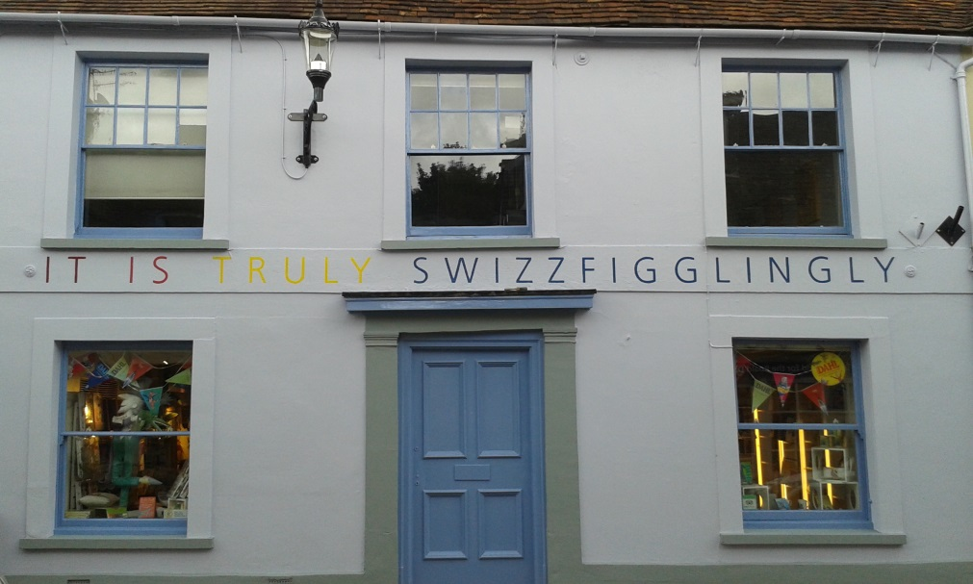
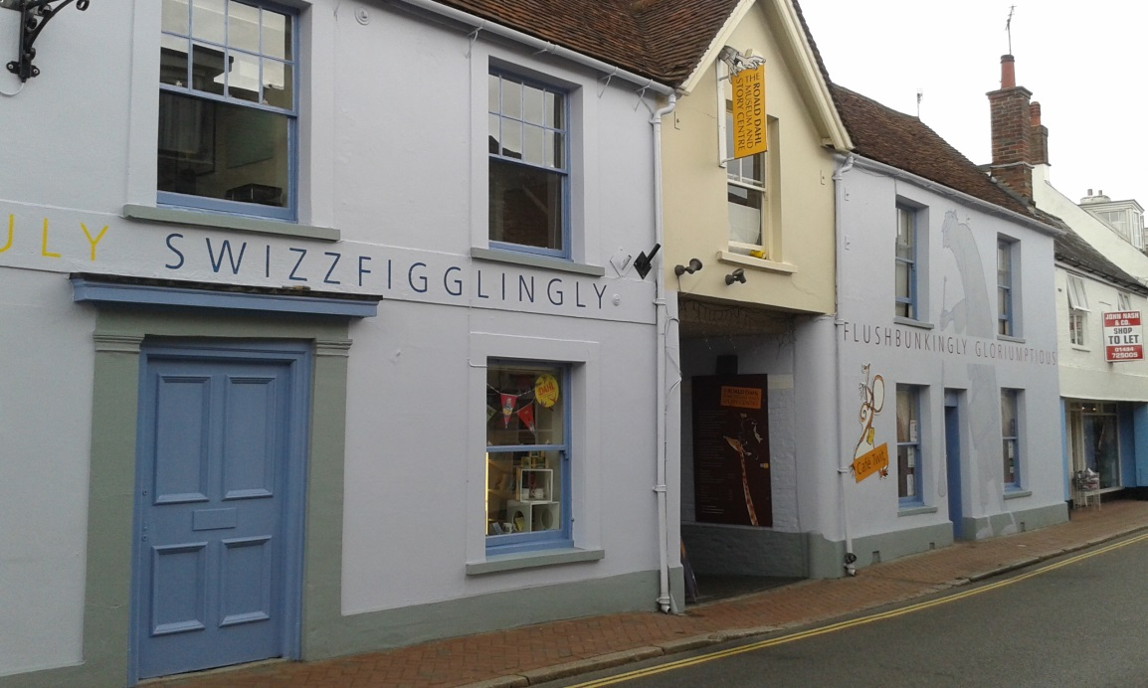
Roald Dahl’s museum

Slide 5
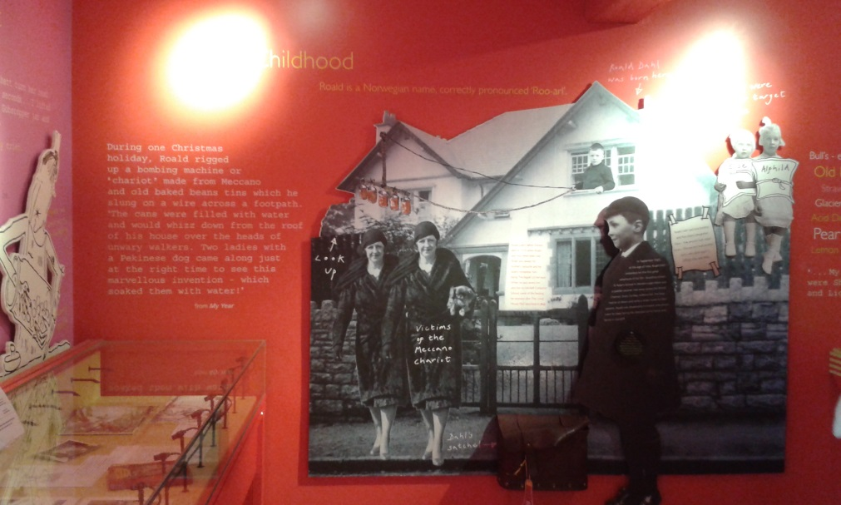
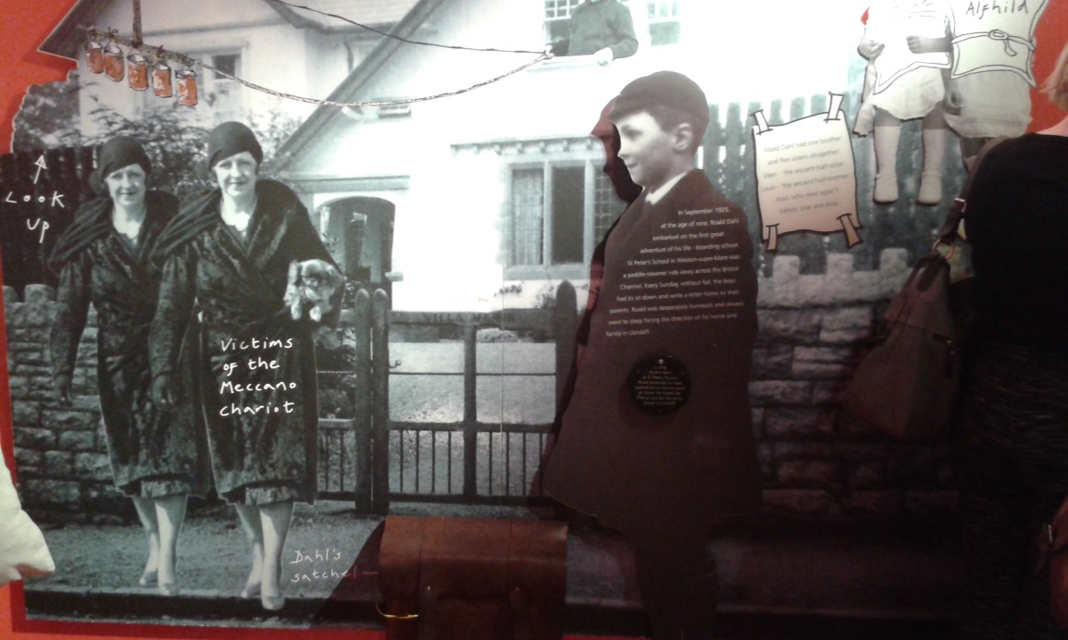
Roald Dahl’s Childhood
He was born in 1916 in Wales to Norwegian parents and spents hos early days in Llandaff, Wales

Slide 6
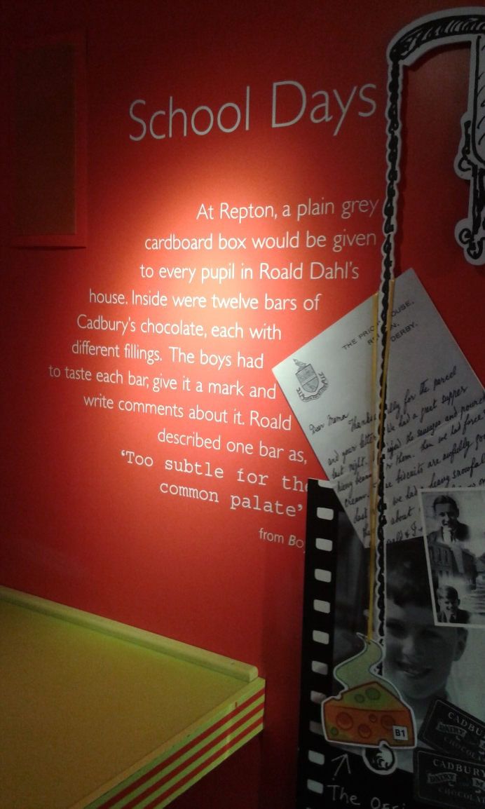
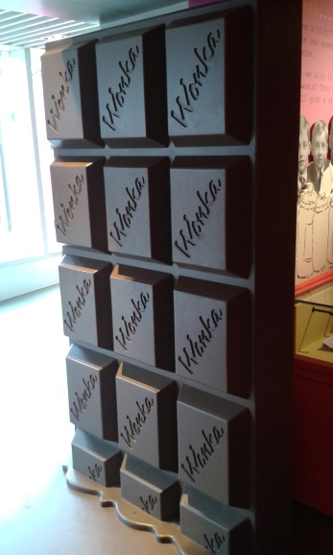
Roald Dahl’s School Days
Following the death of his father and older sister, Roald Dahl begins his schooling in Wales
In 1929 he moves to Rerpton, where he spends the rest of his school days

Slide 7
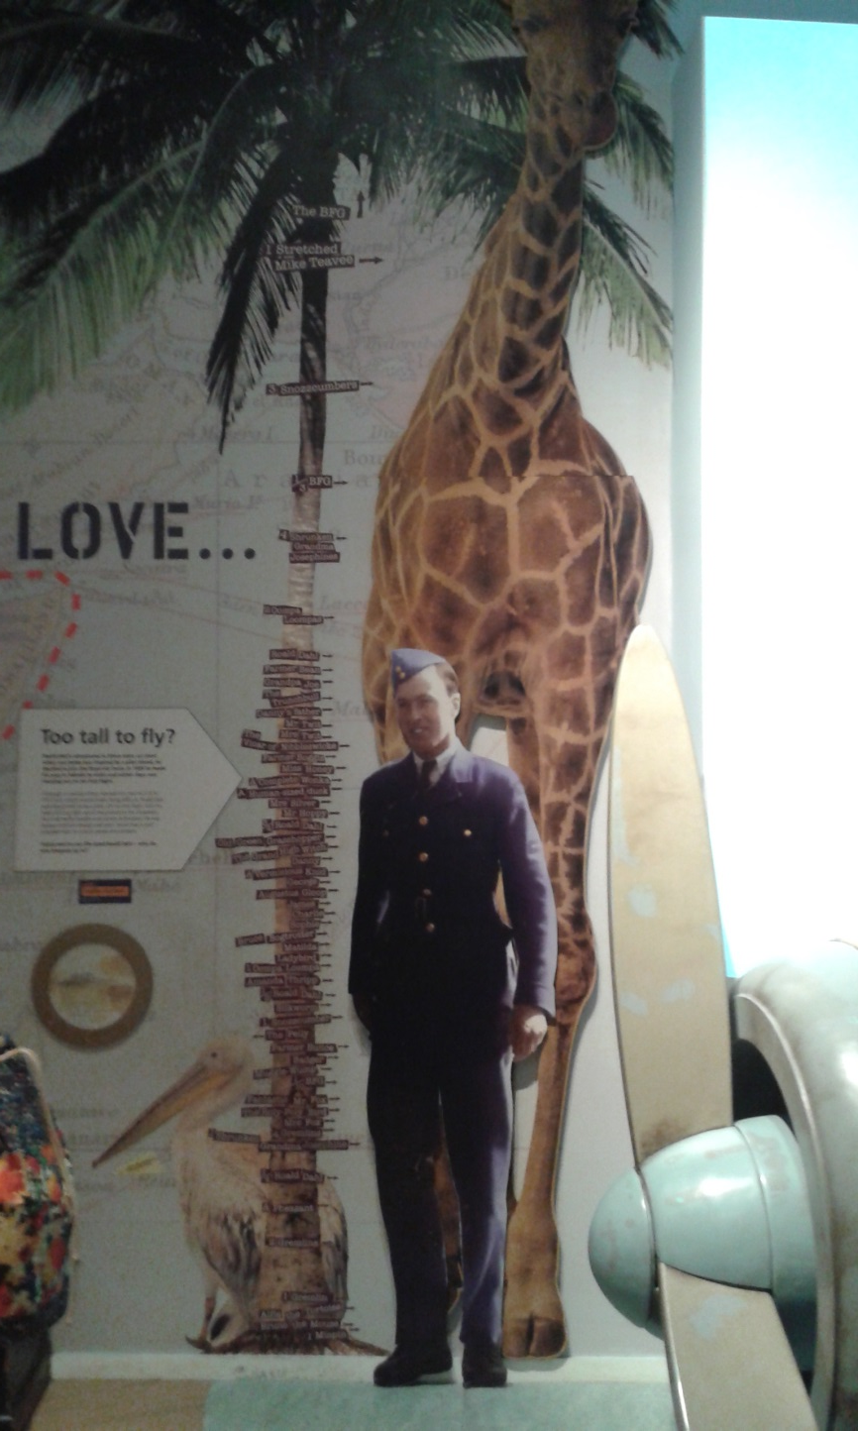
Out of school and working for Shell Oil, the 30s saw Roald Dahl adventuring in Africa before the outbreak of the Second World War

Slide 8
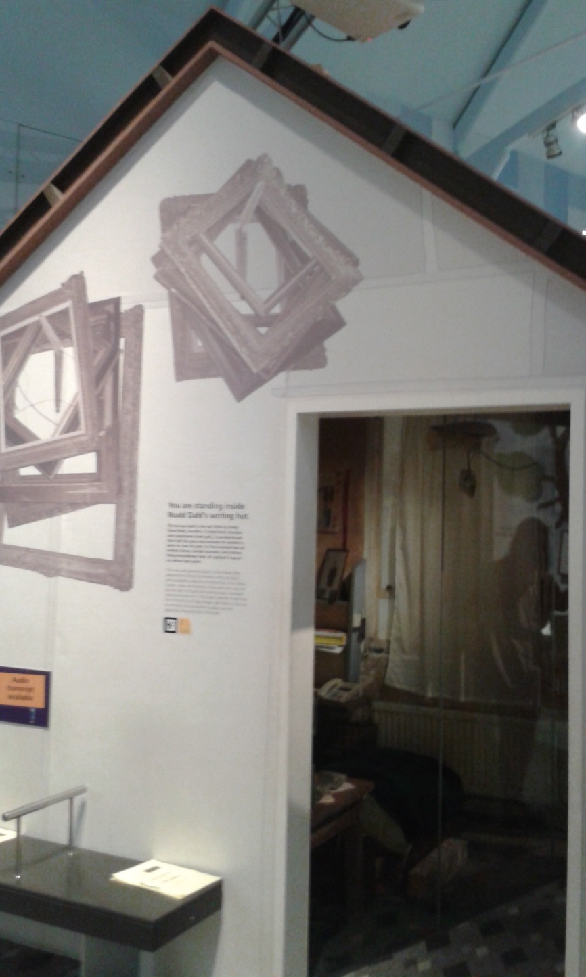
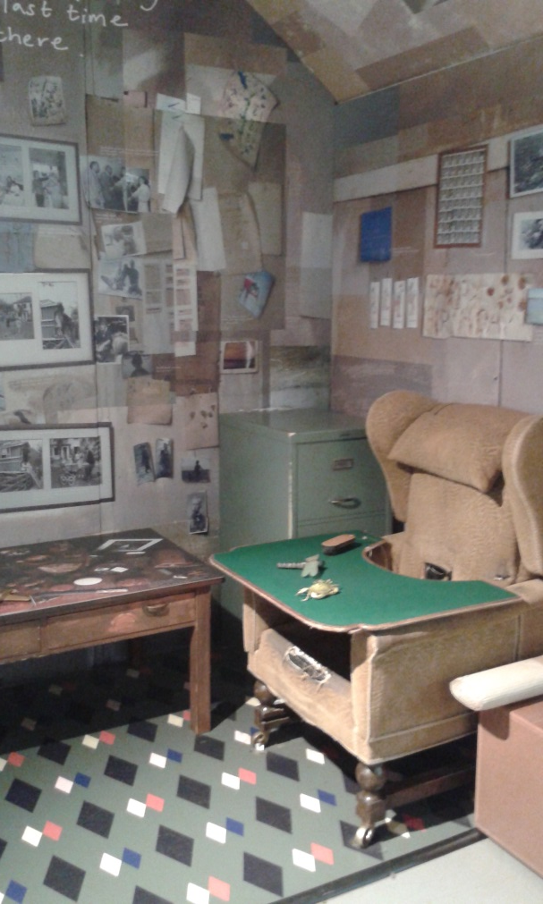
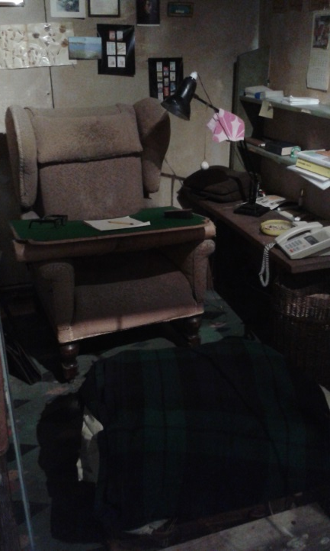
Where Roald Dahl wrote

Slide 9
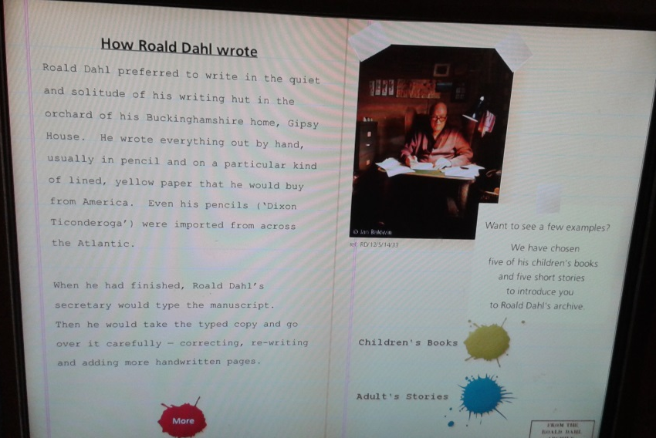
He wrote children’s books

Slide 10
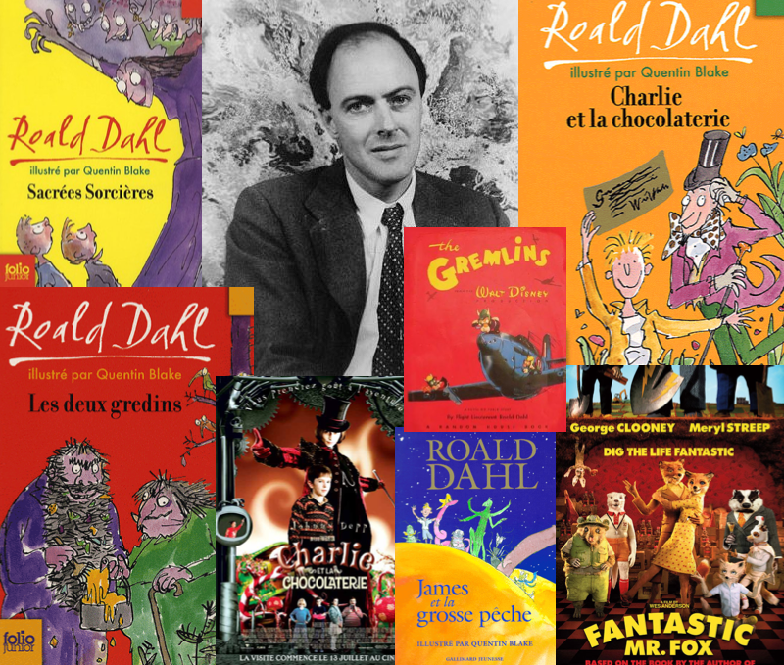

Slide 11
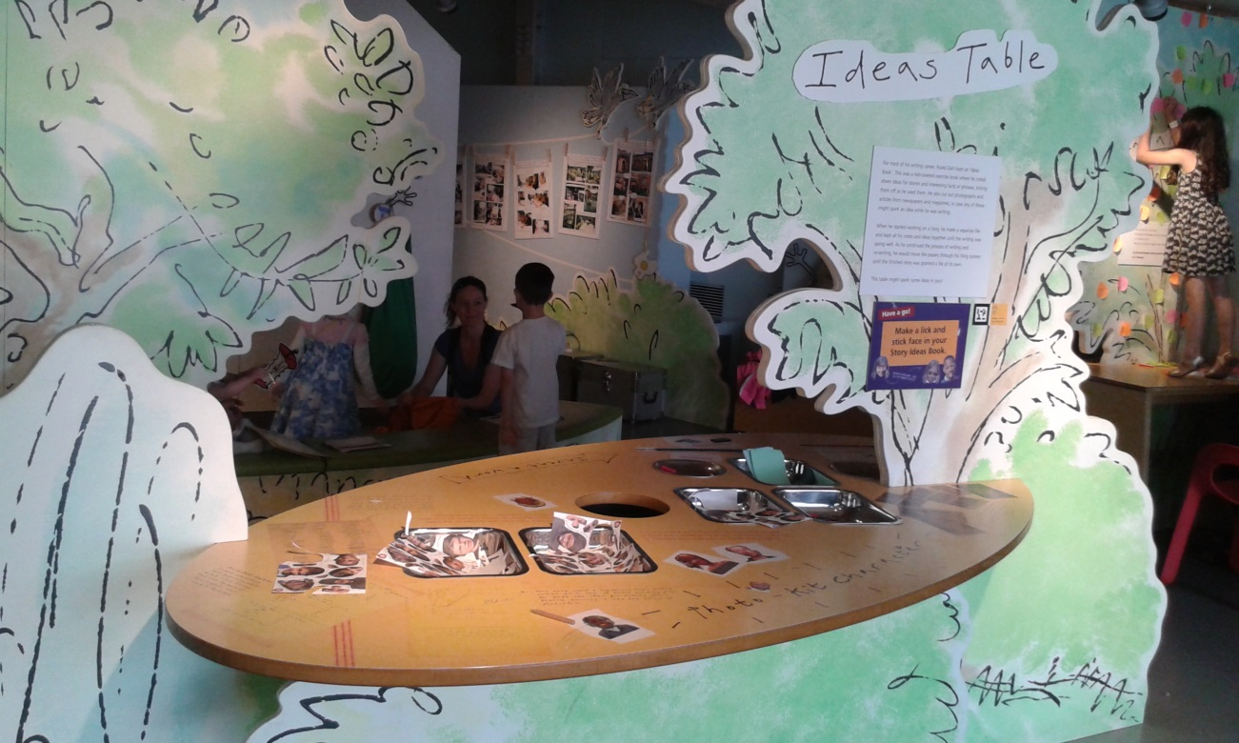
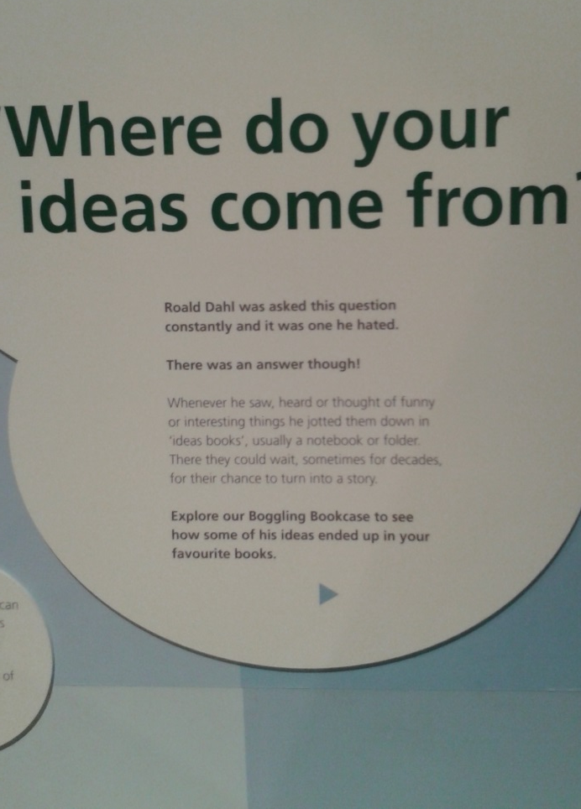

Slide 12
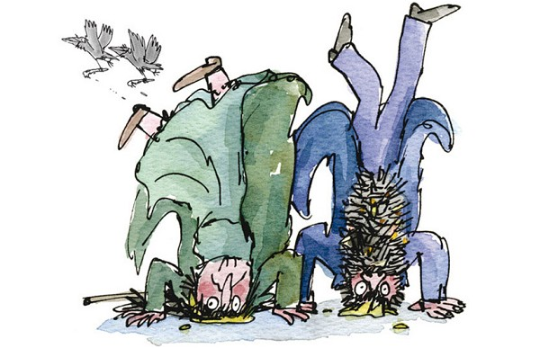
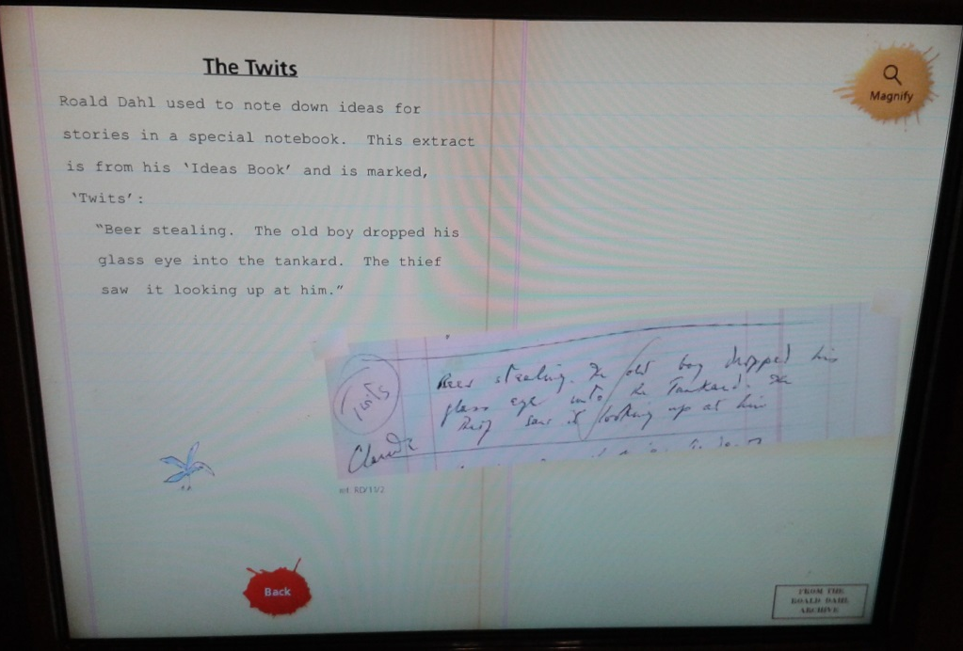

Slide 13
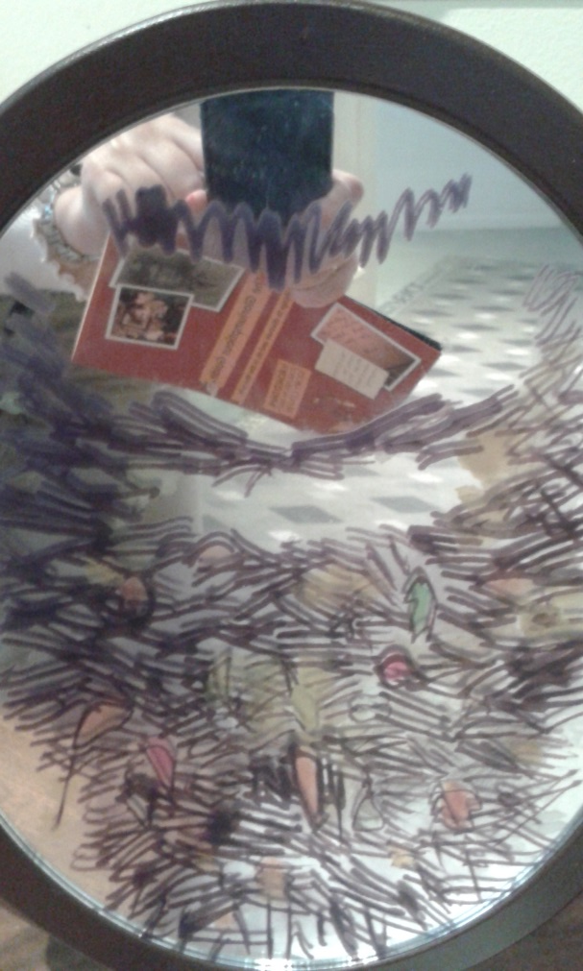
Hairy-faced men

Slide 14
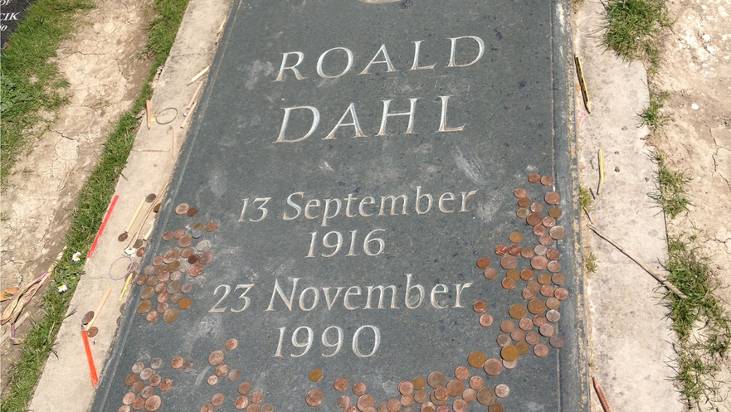
Roald Dahl dies, aged 74. He is buried in the parish church of St Peter and St Paul in Great Missenden.

