Slide 1
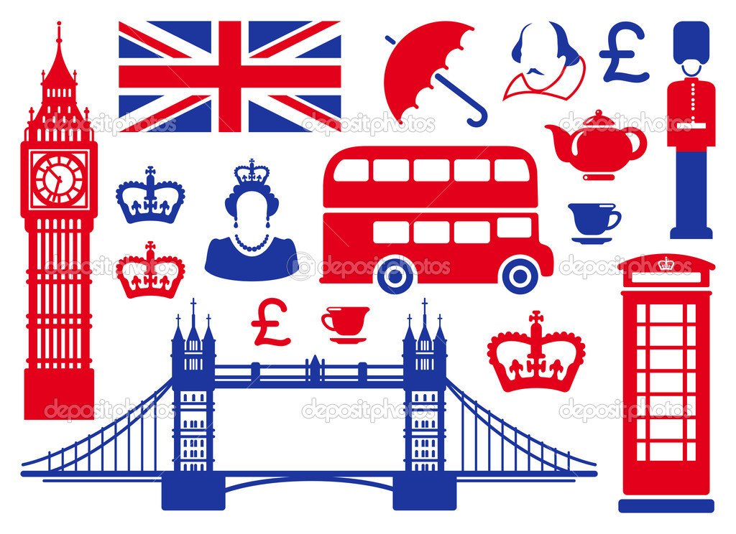
The United Kingdom of Great Britain
QUIZ TIME!

Slide 2
The United Kingdom of Great Britain
What four countries form the UK of Great Britain?
a.
b.
c.
d.

Slide 3
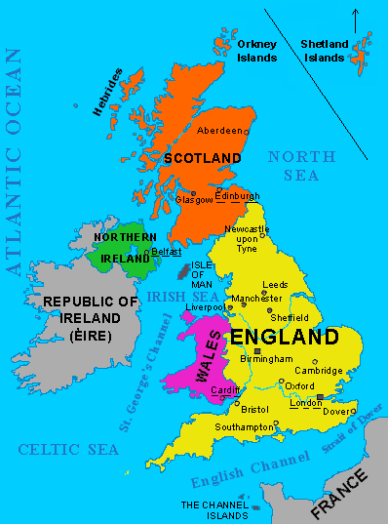
The United Kingdom of Great Britain
The United Kingdom is
formed by
England,
Wales,
Scotland and
Northern Ireland

Slide 4
The United Kingdom of Great Britain
Can you name the capital cities of each country?
England-
Wales-
Scotland-
Northern Ireland-

Slide 5
The United Kingdom of Great Britain
Can you name the capital cities of each country?
England- London
Wales- Cardiff
Scotland- Edinburgh
Northern Ireland- Belfast

Slide 6
The United Kingdom of Great Britain
1. What’s the name of the British flag?
The Union Jack

Slide 7
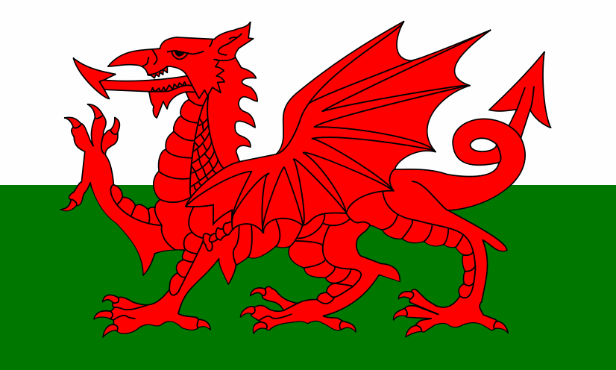
The United Kingdom of Great Britain
What mythological creature appears in the Welsh flag?

Slide 8
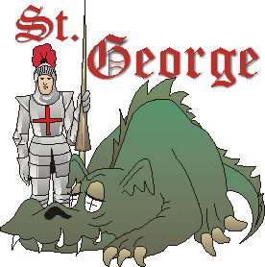
The United Kingdom of Great Britain
St George is the patron saint of…..

Slide 9
The United Kingdom of Great Britain
Can you match these emblems with their corresponding country?
Rose, thistle, shamrock, dragon

Slide 10
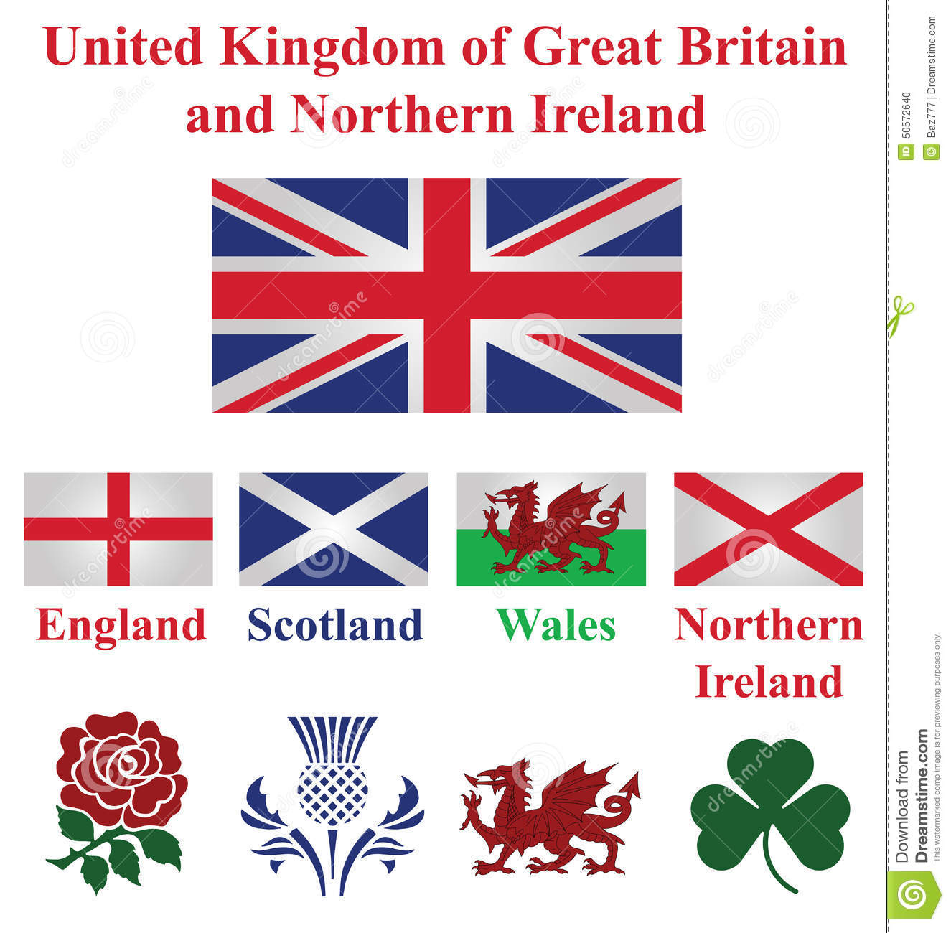
The United Kingdom of Great Britain

Slide 11
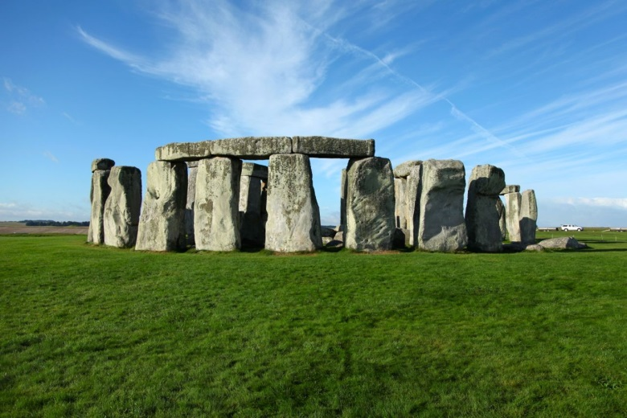
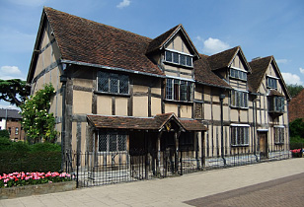
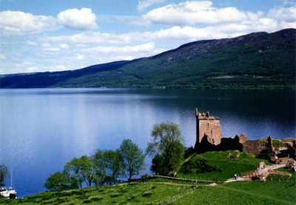
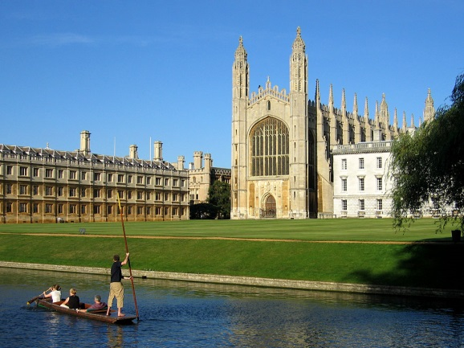
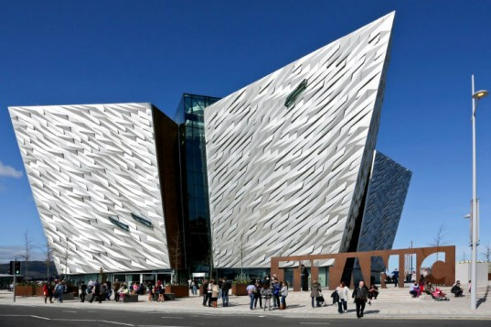
The United Kingdom of Great Britain
Can you recognise the following British landmarks?
2
1
4
3
5

Slide 12
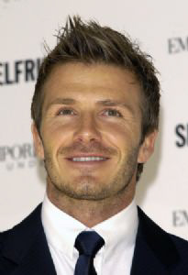
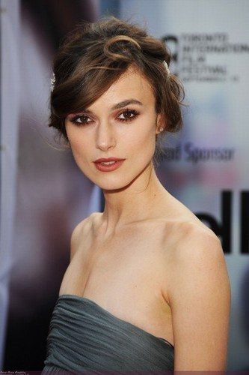
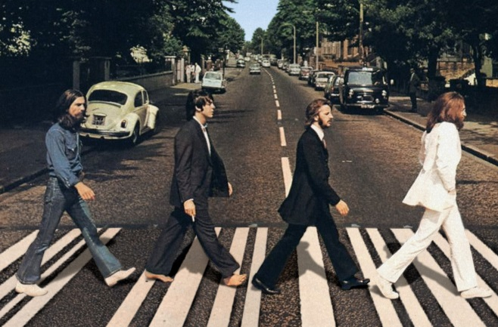
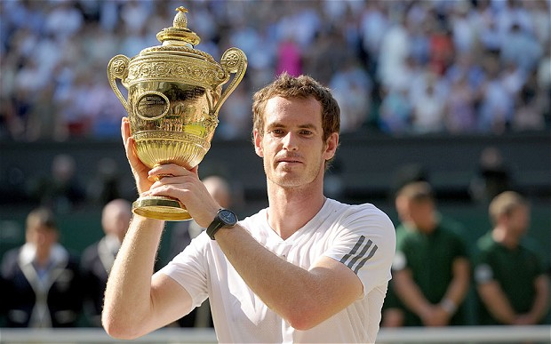
The United Kingdom of Great Britain
Name these famous British people
2
1
4
5
3

Slide 13
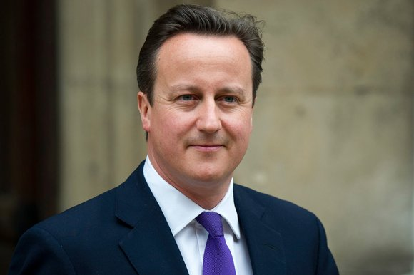
The United Kingdom of Great Britain
They rule the country, who are they?

Slide 14
The United Kingdom of Great Britain
Can you recognise these lyrics?
https://youtu.be/tN9EC3Gy6Nk

