Slide 1
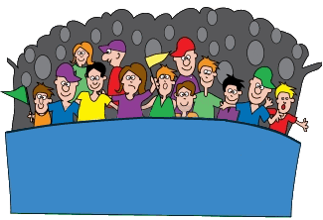
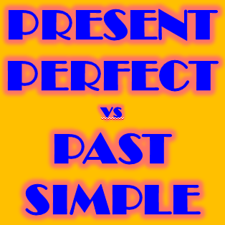
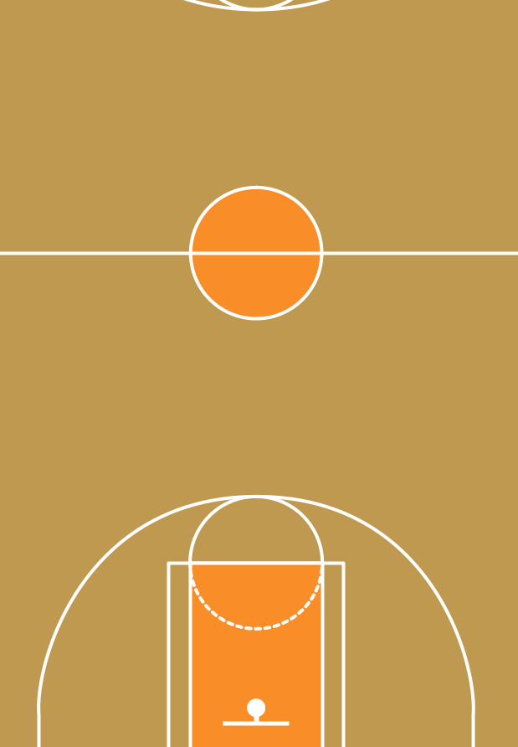

Slide 2
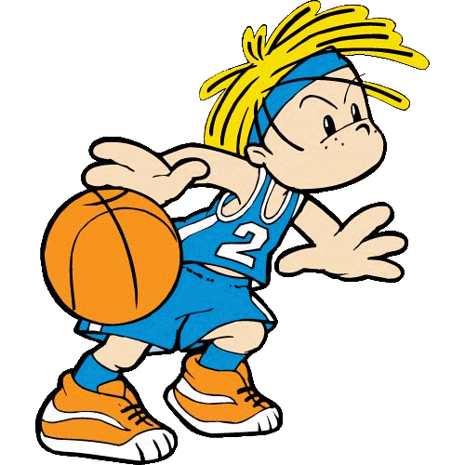
He … his homework.
PRESENT PERFECT – no time reference (the result is more important)
have finished
has finished
finished
finish

Slide 3
We … to a concert last week.
PAST SIMPLE – signal word “last … ” (it tells us when it happened)
have gone
gone
went
go

Slide 4
I … Linda at the cinema yesterday.
PAST SIMPLE – signal word “yesterday” (it tells us when it happened)
seen
has seen
saw
have seen

Slide 5
She … already … breakfast.
PRESENT PERFECT – signal word “already” (for a recently finished action)
has … eaten
has … eat
has … ate
has … eats

Slide 6
Bob … five minutes ago.
PAST SIMPLE – signal word “…ago” (it is a finished past action)
has left
has leave
leave
left

Slide 7
… Mike and Sam… from school yet?
PRESENT PERFECT – signal word “yet” (we expect something to happen soon)
Did / arrive
Did / arrived
Has / arrived
Have / arrived

Slide 8
I … on holidays since Friday .
PRESENT PERFECT – signal word “since” (for an unfinished past action)
was
have been
were
have was

Slide 9
My teacher … just … with my parents.
PRESENT PERFECT – signal word “just” (for a recent event)
has … spoken
have … spoken
spoke
speak

Slide 10
He … early this morning.
PAST SIMPLE –
“this morning” is a completed past period (it’s probably after midday now)
didn’t got up
didn’t get up
hasn’t get up
haven’t get up

Slide 11
When … she … a new car?
PAST SIMPLE–
we want to know when something happened
did … bought
did … buy
has … bought
have … bought

Slide 12
… you ever … a car accident?
PRESENT PERFECT
– signal word “ever” (for past experiences)
Did … had
Has … had
Have … had
Did … have

Slide 13
I … my wife in 2010.
PAST SIMPLE – signal word “in 2010” (for a finished past action)
met
have met
meet
have meet

