Slide 1
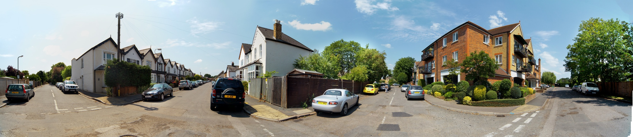
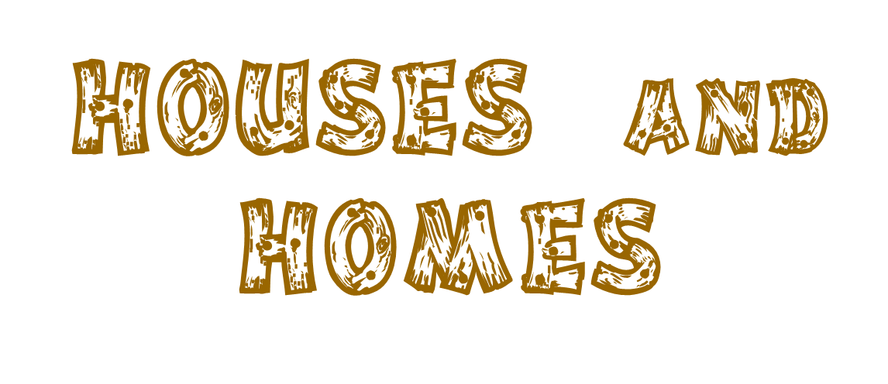
Communicative area: discussing advantages and disadvantages; asking for and giving information
Active vocabulary: an advantage, a disadvantage, responsible, renovations, to repair, repairs, space, to share, an owner, privacy, to rent, upkeep, detached, semi-detached, terraced

Slide 2
What’s home?

Slide 3
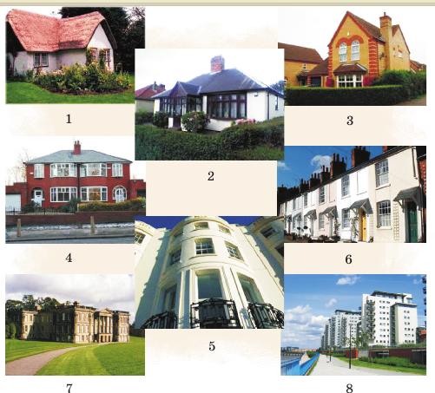
Describe the houses
I’d like to live in… because it looks …
economical
impractical
cold
spacious
comfortable
attractive
eccentric
out of the ordinary
brand new
fashionable
old

Slide 4

Watch and name the houses mentioned in the video

Slide 5
Match and name the types of the houses
cottage;
b) semi-detached house;
c) terraced house;
d) bungalow;
e) detached house;
f) mansion;
g) maisonette;
h) a flat in a block of flats
a
e
d
b
c
g
f
h

Slide 6
Match the types of the houses with their descriptions.
a) cottage;
b) semi-detached house;
c) terraced house;
d) bungalow;
e) detached house;
f) mansion;
g) maisonette;
h) a flat in a block of flats
1. a set of rooms for living in, usually on one floor of a building;
2. several houses joined together;
3. a house which has only one floor (storey);
4. a house which stands alone and is not joined to any other;
5. two houses joined together;
6. a small house in the country usually with a garden;
7. a very large, expensive house;
8. a small apartment on two levels which is part of a larger building but has its own entrance.

Slide 7
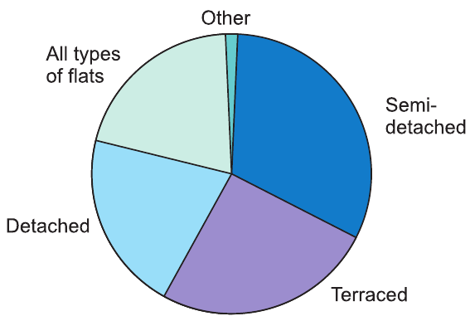
Which type of housing is the most popular in the UK? Which is the least popular?

Slide 8

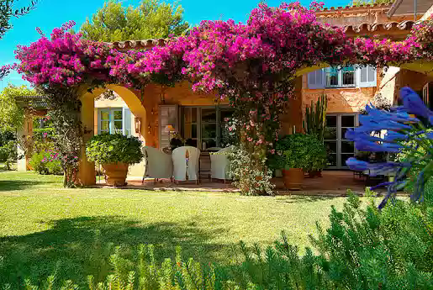








relaxation

Slide 9
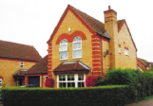
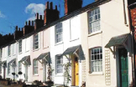
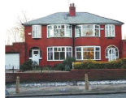
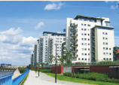
Which types of houses are described?
detached houses
terraced houses
semi-detached houses
flats

Slide 10
oo
space (n) – an empty place (for something).
repair (v, n) – to put (something damaged, broken or not working correctly) back into good condition or make it work again.
owner (n) – If you are the owner of this house, it belongs to you.
share (v) – use something together.
privacy (n) – being alone, a right to keep your personal relationship or matters secret.
responsible (adj) – having control over something or someone and the duty of taking care of it or them.
renovation (n) – process of repairing and making better.
rent (v) – to allow (your house or land) to be lived in or used by someone else in exchange for a payment made regularly.
upkeep (n) – the cost or process of keeping something, such as a building, in good and usable condition.

Slide 11
Complete the sentences with the words from ex. 4a
Is there a lot of space in your house / flat?
How much does it cost to rent a flat in your city or town?
Do you think your house or flat needs any renovation or repair?
Which type of housing gives more privacy: detached, semi-detached, terraced or a flat?
Would you like to be the owner of a mansion?
Do you have to share your house with some neighbours?
Who is responsible for the unkeep of your house or flat: your family or the state?

Slide 12
Types of houses | advantages | disadvantages
detached houses
semi-detached houses
terraced houses
flats

Slide 13
Types of houses | advantages | disadvantages
detached houses | free space surrounding the building is belongs to the family | all repairs in the house should be made by the owner
semi-detached houses | some privacy | responsible for the upkeep of your side of the house cannot just plan repairs or renovations
terraced houses | relatively cheaper than a semi-detached built in the same location | typically no yard or garden that comes with a unit less privacy
flats | you are not responsible for it – you are only renting. | renting out a flat is that it will never be yours do not have the right to make repairs or renovations to suit your needs

Slide 14

6-8 Describe the advantages and disadvantages of your flat.
9-10 Describe the advantages and disadvantages of one of the unique houses in the world.

Slide 15



